Slide 1
POLYMORPHISM

Slide 2
Polymorphism
Polymorphism is the ability of an object or reference to take many different forms at different instances.
These are of two types :
  compile time polymorphism
  run-time polymorphism

Slide 3
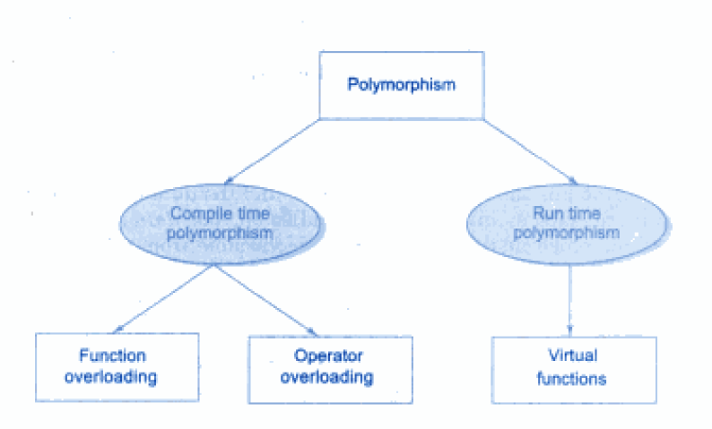
Polymorphism

Slide 4
TYPES OF POLYMORPHISM
Compile time polymorphism: In this method object is bound to the function call at the compile time itself. Also called as early binding or static binding.
Run time polymorphism: In this method object is bound to the function call only at the run time. Also called as dynamic binding and late binding.

Slide 5
EXAMPLE: Complile time
#include <iostream.h>
class Value
{ protected:
int val;
public:
void set_values (int a)
{
val=a;
} };
class C: public Value
{ public:
int cube()
{ return (val*val*val);
} };
int main ()
{
C cb;
Value * ptr = &cb;
ptr->set_values (10);
cout << "The cube of 10 is::" << cb.cube() << endl;
return 0;
}
OUTPUT:
The cube of 10 is:: 1000
Notes:
In the above OOPs example "Cube" is a derived class of "Value". To implement polymorphism a pointer "ptr" is used to reference to the members of the class "Cube". This is an example for "Compile time polymorphism."

Slide 6
EXAMPLE: Run time
class tape: public media
{
float time;
public:
tape(char *s,float a, float t):media(s,a)
{
time=t;
}
void display();
};
void book:: display()
{
cout<<“\n title:”<<title;
cout<<“\n pages:”<<pages;
cout<<“\n price:”<<price;
}
void tape:: display()
{
cout<<“\n title:”<<title;
cout<<“\n ”<<time<<“mins”;
cout<<“\n price:”<<price;
}
#include<iostream.h>
class media
{
protected:
char title[50];
float price;
public:
media(char *s, float a)
{
strcpy(title, s);
price = a;
}
virtual void display() { } // empty virtual function
};
class book: public media
{
int pages;
public:
book(char *s, float a, int p): media(s,a)
{
pages = p;
}
void display();
};

Slide 7
int main()
{
char *title = new char[30];
float price, time;
int pages;
// book details
cout<<“enter book details:”;
cout<<“title:”; cin>>title;
cout<<“price:”; cin>>price;
cout<<“pages:”; cin>>pages;
book book1(title, price, pages);
// tape details
cout<<“enter tape details:”;
cout<<“title:”; cin>>title;
cout<<“price:”; cin>>price;
cout<<“play time(mins):”; cin>>time;
tape tape1(title, price, time);
media* list[2]; //polymorphism
list[0] =&book1;
list[1] = &tape1;
cout<<“ Media details”;
cout<<“\n….book…”;
list[0] -> display(); // display book details
cout<<“\n…..tape….”;
list[1] -> display(); // display tape details
return 0;
}

Slide 8
OUTPUT:
Enter book details
title: Programming in C
price: 188
pages: 400
Enter tape details
title: Computing concepts
price: 99
play time(mins): 55
Media details
……Book…….
title: Programming in C
price: 188
pages: 400
……Tape……
title: Computing concepts
price: 99
play time(mins): 55

Slide 9
EXAMPLE
#include <iostream>
class Shape
{
protected:
int width, height;
public:
Shape( int a=0, int b=0)
{
width = a;
height = b;
}
int area()
{
cout << "Parent class area :" <<endl;
return 0;
} };
class Rectangle: public Shape
{
public:
Rectangle( int a=0, int b=0): Shape(a, b)
{ }
int area ()
{
cout << "Rectangle class area :" <<endl;
return (width * height);
} };
class Triangle: public Shape
{
public:
Triangle( int a=0, int b=0):Shape(a, b)
{ }
int area ()
{
cout << "Triangle class area :" <<endl;
return (width * height / 2);
} };
// Main function for the program
int main( )
{
Shape *shape;
Rectangle rec(10,7);
Triangle tri(10,5); // store the address of Rectangle shape = &rec; // call rectangle area.
shape->area(); // store the address of Triangle
shape = &tri; // call triangle area.
shape->area();
return 0;
}

Slide 10
When the above code is compiled and executed, it produces the following result:
Parent class area
Parent class area
The reason for the incorrect output is that the call of the function area() is being set once by the compiler as the version defined in the base class.
This is called static resolution of the function call, or static linkage - the function call is fixed before the program is executed. This is also sometimes called early binding because the area() function is set during the compilation of the program.

Slide 11
Now if we precede the declaration of area() in the Shape class with the keyword virtual then:
class Shape
{
protected:
int width, height;
public:
Shape( int a=0, int b=0)
{
width = a;
height = b;
}
virtual int area()
{
cout << "Parent class area :" <<endl;
return 0;
} };

Slide 12
Now the output of the program will be:
Rectangle class area
Triangle class area
This time, the compiler looks at the contents of the pointer instead of it's type. Hence, since addresses of objects of tri and rec classes are stored in *shape the respective area() function is called.

Slide 13
Virtual function
When the same function name is used in the base and derived classes, the function in base class is declared as virtual using the keyword virtual preceding its normal declaration.
Virtual means existing in appearance but not in reality.
Virtual functions are used in late binding or dynamic binding.
The concept of pointers play important role in the virtual functions.
When a function is virtual, C++ determines which function to use at run time based on the type of object pointed to by the base pointer rather than the type of pointer.

Slide 14
The selection of the function to be called at any given point in the program to be based on the kind of object for which it is called. This sort of operation is referred to as dynamic linkage, or late binding.

Slide 15
Rules for virtual function
It must be members of some class.
They can not be static.
They are accessed by using object pointers.
It can be friend of another class.
Virtual function in base must be defined even though it is not used.

Slide 16
Incrementing decrementing base pointer does not effect the derive class.
If virtual function is defined in base class, not necessary to redefine in derive class.

Slide 17
Early binding or complie time binding or static binding
Late binding or runtime binding or dynamic binding.

Slide 18
Static Binding
Binding means linking.
In c++, programs choosing the function in a normal way during the compilation time is called the static binding or static linking or compile time binding or early binding.
In this, compiler determines which function is to be used based upon the parameters passed to the function.

Slide 19
Late Binding or Dynamic Binding
The concept of late binding is dependent on the virtual function.
The linking of the functions at run time is called run time binding.

Slide 20
Pure Virtual Function
A pure virtual function is a virtual function which has no body i.e no arguments, no variables and no expressions or statements inside it.
It's possible to declared a pure virtual function in a base class so that it may be redefined in a derived class to suit the objects of that class, but has no definition relative to the base class.

Slide 21
Why we use Pure virtual function??
To make the code simpler.
To access the members of derived class through the pointer of base class, we need virtual functions.
But if the virtual function is of no use, because it will not be called then we make it as pure virtual function.

Slide 22
Pure Virtual Function
Is a function without a body
Is created by adding the notation ‘=0’ to the virtual function declaration
Example:
virtual int sum()=0;

Slide 23
Example
class shape
{
protected:
int a,b;
public:
void read()
{
cin>>a>>b;
}
virtual void cal_area()=0;
};
class rectangle:public shape
{
void cal_area()
{
doubles area=a*b;
cout<<area;
}
};
class triangle:public shape
{
void cal_area()
{
doubles area=(a*b)/2;
cout<<area;
}
};
int main()
{
shape *ptr[2];
rectangle r1;
cout<<“enter leng n bredth”;
r1.read();

Slide 24
Example
triangle t1;
cout<<“enter base n perpendicular”;
t1.read();
ptr[0]=&r1;
ptr[1]=&t1;
for(int i=0;i<2;i++)
ptr[i]->cal_area();
}
OUTPUT
Enter length and breadth 10 20
Enter base and perpendicular 5 20
Area of rectangle=200
Area of triangle=50

Slide 25
Abstract base class
The class in which at least one pure virtual function declared is called an abstract base class.
We can not create object of the abstract class, but we can create pointer to that class.
A class that does not have a pure virtual function is called a concrete class.

Slide 26
Virtual destructor
"A destructor is a member function of a class, which gets called when the object goes out of scope". This means all clean ups and final steps of class destruction are to be done in destructor.
The order of execution of destructor in an inherited class during a clean up is like this.
1. Derived class destructor
2. Base class destructor
In inheritance, when the object of the base class is deleted, the destructor for derived class does not get called at all.

Slide 27
#include <iostream.h>
class Base
{
public:
Base(){ cout<<"Constructor: Base"<<endl;}
~Base(){ cout<<"Destructor : Base"<<endl;}
};
class Derived: public Base
{
//Doing a lot of jobs by extending the functionality
public:
Derived(){ cout<<"Constructor: Derived"<<endl;}
~Derived(){ cout<<"Destructor : Derived"<<endl;}
};
void main()
{
Base *Var = new Derived();
delete Var;
}
OUTPUT: Constructing Base
Constructing Derive
Destroying Base

Slide 28
Virtual destructor
This problem can be fixed by making the base class destructor virtual and this will ensure that the destructor for any class that derives from base will be called.

Slide 29
Virtual destructor
class Base
{
public:
Base()
{
cout<<"Constructing Base";
}
// this is a virtual destructor:
virtual ~Base()
{
cout<<"Destroying Base";
} };
OUTPUT: Constructing Base
Constructing Derive
Destroying Derive
Destroying Base

